Slide 1



Product Release

Slide 2

Definitions/Acronyms:
Term/Acronym | Definition
A-SPICE | Automotive Software Process Improvement and Capability Determination
SYS | System Engineering
SWE | Software Engineering
Workflow | Definition, execution and automation of business processes where tasks, information or documents are passed from one participant to another for action, according to a set of procedural rules.
Trace | Link between two meaningful contents in a document

Slide 3
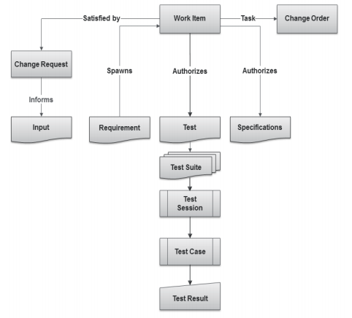
What Are Items?
  Items are the basic building blocks of the Integrity data model, and represent the information assets and process objects associated with software development.
  For example, items can represent Work items, projects, requirements, test cases, change requests, and defects.
  Every item is configurable and contains metadata and history about that item.
  Every item type has its own enforceable workflow which describes how it moves from state to state, complete with definable rules, full audit trails, and security.
  Escalations, conditional assignments, notifications, and external processes can all be defined and initiated as part of Integrity’s process automation

Slide 4
Creating a Product Release

Slide 5
Creating Product Release
Select Create Item menu to create a new Product Release Item in Integrity.
Steps:
1.Creating Product Release
2.Editing data in Item view
3.Applying changes in created item
4.Item Details View
5.Product Release Workflow

Slide 6
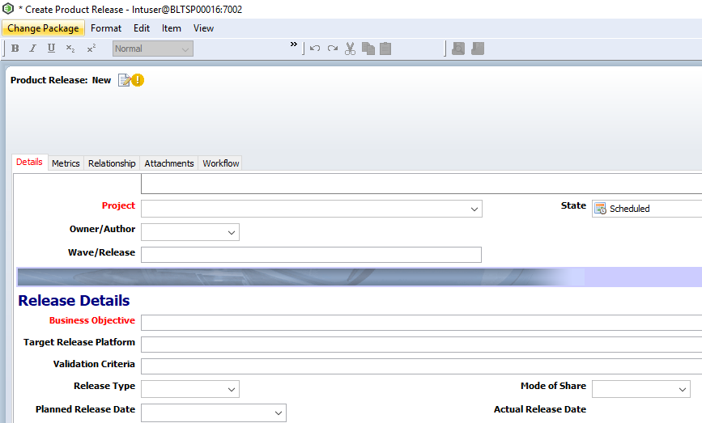
Creating Product Release
Item details view will open up. Enter or select correct values for the fields present. Enter values in all fields. Mandatory fields are marked Red.
Steps:
1.Creating Product Release
2.Editing data in Item view
3.Applying changes in created item
4.Item Details View
5.Product Release Workflow

Slide 7
Creating Product Release
All other fields visible in the Item Details view must be filled.
Clicking on “Apply” will keep the user on the same screen while clicking on “OK” will show the user a non-editable form-like view.
Clicking “Apply” will save the document. Alternately “Ctrl + S” can also be used.
Click on “OK” to finish creating.
Steps:
1.Creating Product Release
2.Editing data in Item view
3.Applying changes in created item
4.Item Details View
5.Product Release Workflow

Slide 8
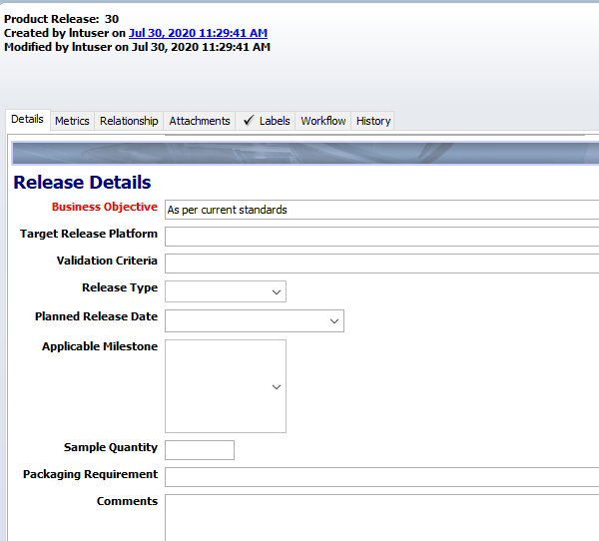
Creating Product Release
Once user clicks on “Apply”, the Item Details view will appear as follows:
Steps:
1.Creating Product Release
2.Editing data in Item view
3.Applying changes in created item
4.Item Details View
5.Product Release Workflow

Slide 9
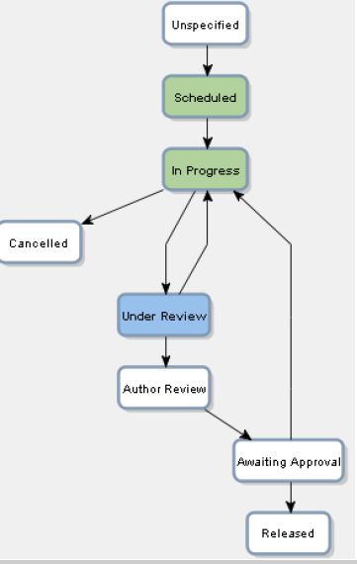
Creating Product Release
The workflow will be as follows:
Steps:
1.Creating Product Release
2.Editing data in Item view
3.Applying changes in created item
4.Item Details View
5.Product Release Workflow

Slide 10
Product Release –Details Tab
The Details tab contains the following sections:
General Section
Release Details Section
General Section consists of the following fields:
Summary: Short Title for the Product Release
Description: Brief introduction of the Product Release Item
Project: Project for which the Product Release will take place
State: State of the item based on workflow. (Default state selected will be “Scheduled”)
Owner/Author: Select Owner of the item.
Wave/Release: Specify Wave/Release of the Product

Slide 11
Product Release –Details Tab
Release Details Section consists of the following fields:
Business Objective: Specify the objective to be achieved with the release.
Target Release Platform: Brief introduction of the Product Release Platform
Validation Criteria: Mention criteria for Validating release
Release Type: Select based on Planned, Unplanned or Change Driven
Mode of Share: Communication means to be selected
Planned Release Date: Date decided for Product Release
Actual Release Date: Date will be auto-populated when item goes to “Released” state.
Application Milestone: Select the appropriate milestone.
Software Version: if the product release is software related, then mention Software Version. Eg. 2.0.1.1.2
Sample Quantity: Mention the number of samples to be released.
Packaging Requirements: Mention pre-requisites for packaging the product to be released.
Comments: Mention comments if any.

Slide 12
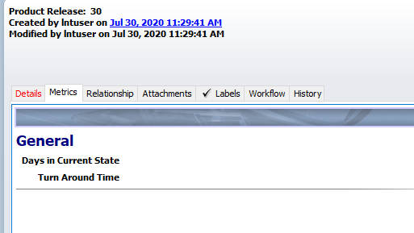
Product Release –Metrics Tab
Metrics tab contains item metrics namely:
Days in Current State: Mentions number of days the item is in current state.
Turn Around Time: Mentions time to complete Workflow.

Slide 13
Product Release –Relationships Tab
The Relationships tab include the following fields:
Product Release For: User can attach Related item to this field for which the Product Release is carried out.
  Also the user can create related item by clicking on symbol.
  Related item is Product Release Plan.
Build Form: User can attach attachments which are build forms.
Release Package: User can attach attachments which are release package files.
Checklist: User can attach checklist associated with the product release.
.

Slide 14
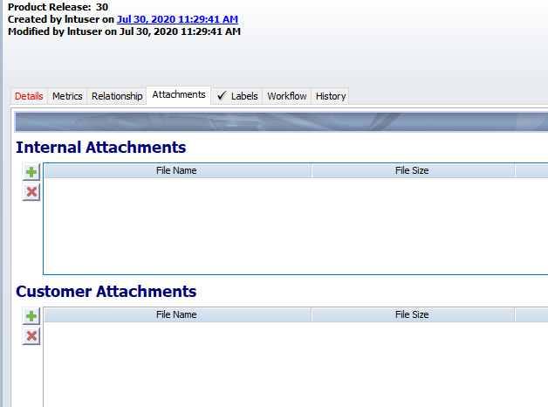
Product Release –Attachments Tab
Attachment tab avails users to add project/document related files to the Product Release :
₋Internal Attachments –Company related attachments
₋Customer Attachments –Related documents given by customers
Note: Attachments can be of any file format. It should not exceed the size of 5MB.

Slide 15
Understanding Review and Approval mechanism

Slide 16
Understanding Review and Approval mechanism
After the Product Releases have been created, they shall be reviewed and approved.
Review and Approval depends on the workflow any document goes through.
Product Releases
Primary Actor:
Lead/Manager
Workflow of Product Releases
in Integrity

Slide 17
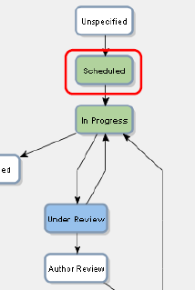
Understanding Review and Approval mechanism
Once Product Release is created, the item will be in Scheduled state.
In order to forward it to next state i.e. “In Progress”, user need to open the document and click on the dropdown of field state and select “In Progress”.
Owner/Author field becomes mandatory.
Select the owner of the document from the dropdown.
Mandatory Fields:
Owner/Author

Slide 18
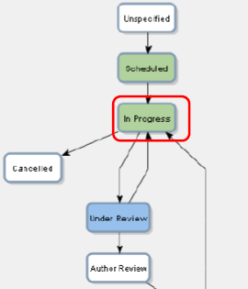
Understanding Review and Approval mechanism
After successfully creating and modifying the Product Release, it will go in “In Progress” state.
If by any chance the Product Release becomes unsuccessful or gets cancelled, the user can change the state of the Product Release Item to “Cancelled” state.
Once the state is changed to cancelled, it cannot be reverted back.
If everything is going according to the plan, keep maturing the item.
Mandatory Fields:
Owner/Author

Slide 19
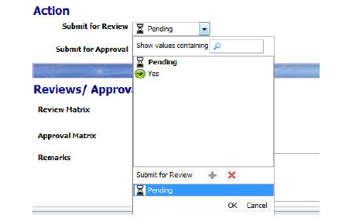
Understanding Review and Approval mechanism
After successfully creating and modifying the Product Release, it will go in“ In Progress” state.
In order to forward it to next state i.e. “ Under Review”, user need to open the document and click on the dropdown of field “Submit for Review”. By default the value will show as“ Pending”. Select“ Yes”.
Mandatory Fields:
Owner/Author

Slide 20
Understanding Review and Approval mechanism
As soon as “ Yes” is selected, “Reviewers Required” field will be visible where the user needs to select the designated reviewer i.e. Lead Engineer.
Click on Apply. The state of the document will be automatically transited to
“ Under Review”. The control of the document will be given to the Reviewer.
Mandatory Fields:
Owner/Author

Slide 21
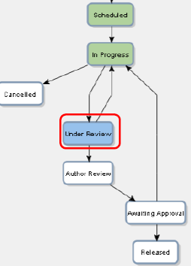
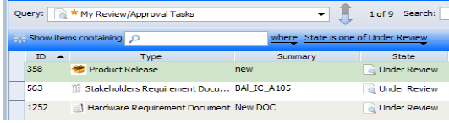
Understanding Review and Approval mechanism
The Lead Engineer will receive the document for review. This document will be available for reviewing in your “My Review/Approval Tasks” query.
The Reviewer will check the document for errors and changes required. If the document is correct, he/she must select “ Yes” in “Review Complete?” field else select “ No” of wrong.
Note: The Review Matrix will contain the reviewer’s name and will record and update his review in the table automatically.
Mandatory Fields:
Owner/Author

Slide 22
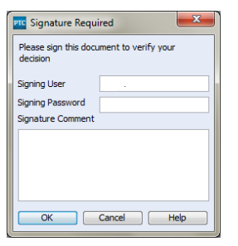
Understanding Review and Approval mechanism
On specifying your review, Integrity will authenticate you by asking for your Digital Signature.
Here you need to enter your Integrity login credentials and enter comments and then click “OK”.
Mandatory Fields:
Owner/Author

Slide 23
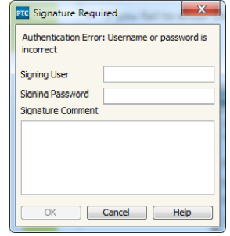
Understanding Review and Approval mechanism
If you fail to enter the correct username or password while signing, it will prompt the user an “Authentication Error”.
Similarly it will also provide an error if the signature comments are mandatory and not entered.
Mandatory Fields:
Owner/Author

Slide 24
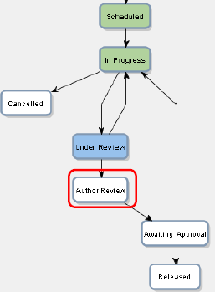
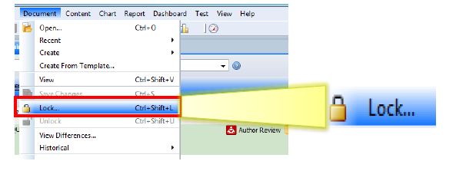
Understanding Review and Approval mechanism
After successful completion of review, the document transition happens on the basis of review performed.
When the document is under “ Author Review” state, only the Document Author will be able to edit some fields in the document by locking the document.
Mandatory Fields:
Owner/Author

Slide 25
Understanding Review and Approval mechanism
On making the required changes, document must be submitted for Approval to the designated approver i.e. Manager.
Select “ Yes” in “Submit for Approval” field.
Select the Approver from “Approvers Required” field.
Note: The document will not proceed to next state if document is locked. The document must be unlocked by the user who locked it in order to transit the document further.
Mandatory Fields:
Owner/Author

Slide 26
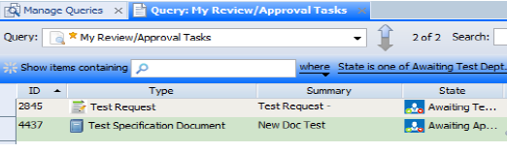
Understanding Review and Approval mechanism
The Manager will receive the document for approval. This document will be available for approval in your “My Review/Approval Tasks” query.
The Reviewer will check the document for errors and changes required. If the document is correct, he/she must select “ Yes” in “Do you Approve?” field else select “ No” of wrong.
Note: The Approval Matrix will contain the approver’s name and will record and update his approval in the table automatically.
Mandatory Fields:
Owner/Author

Slide 27
Understanding Review and Approval mechanism
On specifying your Approval, Integrity will authenticate reviewer (user) by asking for your Digital Signature.
Here you need to enter your Integrity login credentials and enter comments and then click “OK”.
Mandatory Fields:
Owner/Author

Slide 28
Understanding Review and Approval mechanism
If you fail to enter the correct username or password while signing, it will prompt the user an “Authentication Error”.
Similarly it will also provide an error if the signature comments are mandatory and not entered.
Mandatory Fields:
Owner/Author

Slide 29
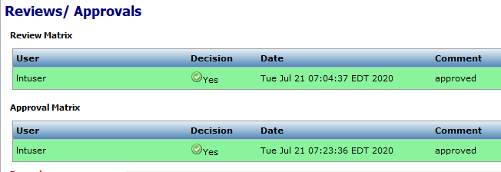
Understanding Review and Approval mechanism
On applying the changes, the approval matrix updates itself.
After successful completion of review, the document transition happens on the basis of review performed.
Once everyone approves the document automatically moves to “Released” state.
Mandatory Fields:
Owner/Author

Slide 30

Thank you
Thank you

